Slide 1


Q3 MEETING
Opening and Strategic Framing
Focused growth
Chenson Johnson
Chief Visionary Officer
Notes:
• Good morning. Setting the stage for our Q3 review.
• How the next five weeks will work and what we need from each other.
• This prepares us for the major Q4 meeting.
• Theme: focused growth — services, people and resources behind clear priorities.

Slide 2

THE NEXT FIVE WEEKS
Our approach
Q3 review presentations
Each person highlights their area during our business meetings.
Q4 preparation series
Mr. Roberts leads a weekly segment on strategic vision and execution alignment.
Proficient Business Services Ltd.
02
Notes:
• Normally one full session for the quarterly review.
• This time: presentations spread across the next five weeks.
• Each person: results, challenges, recommendations.
• Mr. Roberts runs a five-week series to prepare us for Q4.

Slide 3
CONNECTED PARTS
How the sessions work together
1
→
2
→
3
Q3 review
Mr. Roberts’ series
Q4 meeting
Establishes where PBS stands.
Prepares us to evaluate direction and execution.
Both inform the decisions we bring forward.
Proficient Business Services Ltd.
03
Notes:
• Presentations give a clear picture of the business.
• Mr. Roberts helps us see what it means for direction and execution.
• Build on each week — if it affects your area, follow up and bring something back.
• Arrive at Q4 having done the serious thinking.

Slide 4
“
OUR CENTRAL QUESTION
Where should PBS concentrate its efforts and resources to achieve sustainable growth while delivering legendary service?
Proficient Business Services Ltd.
04
Notes:
• Keep this question in front of us for all five weeks.
• Many opportunities — but people, time and money have limits.
• Decide where resources make the greatest difference.
• Protect the service standard clients expect.

Slide 5
LOOKING BACK
What we need to learn from Q3
01
02
Results against our commitments
What worked and what needs improvement
03
04
The cost and effort required to deliver
Lessons we can apply to future work
Proficient Business Services Ltd.
05
Notes:
• Recognise the work and the people who stepped up.
• Then look carefully at what that effort produced.
• Did we deliver? Did clients get the intended experience? Were results as expected?
• Find weaknesses in planning or coordination before they repeat.

Slide 6

LOOKING WITHIN
Our capacity to deliver
1
Do our skills match the work we are pursuing?
2
Can our teams meet existing commitments?
3
Where do processes or handoffs cause delays?
4
What requires executive intervention too often?
Proficient Business Services Ltd.
06
Notes:
• Is capacity keeping pace with ambition?
• If the same people keep rescuing work — find out why.
• Skills, unclear responsibility, process gap or resources?
• Establish the cause before choosing the solution.

Slide 7

WHAT IT MEANS FOR PBS
Sustainable growth
Financial
Delivery
Capacity
Profitable work and healthy cash flow
Reliable delivery and consistent client service
People and systems that can support greater demand
Proficient Business Services Ltd.
07
Notes:
• Growth is more than revenue — profit and cash flow matter.
• We must deliver consistently.
• Toward Total IT Care: what can clients depend on us for today?
• Link commercial opportunity to our ability to deliver.

Slide 8
FOCUS
Clear priorities require choices
01
02
Which services deserve more attention?
Where can we improve what we already offer?
03
04
What resources would a new commitment require?
What should we reduce, defer or stop?
Proficient Business Services Ltd.
08
Notes:
• Everything sounds important on its own.
• Together, we must decide what we can realistically support.
• New work: who owns it, and what does it displace?
• Better tools, handoffs and less rework can lift results without new services.

Slide 9
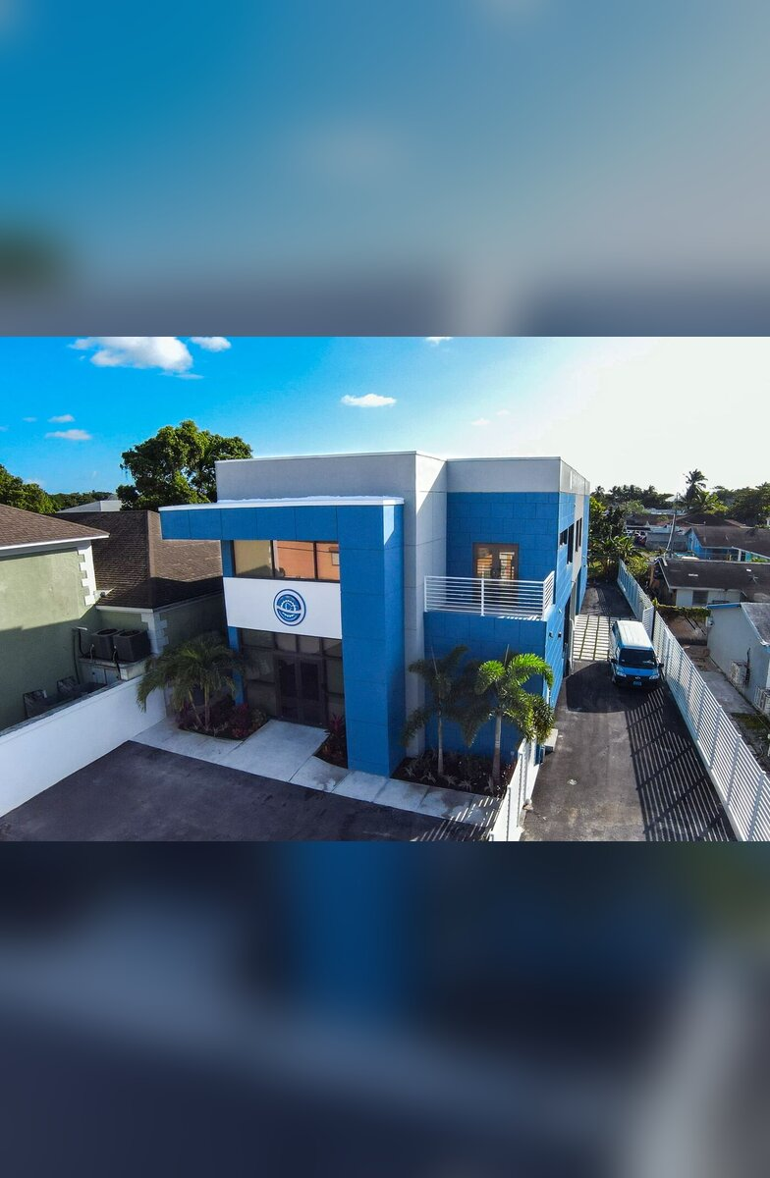
YOUR PRESENTATION
What each presentation contributes
1
Q3 results supported by evidence
2
Constraints and their effect on performance
3
Recommendations and resource requirements
4
Questions for collective executive consideration
Proficient Business Services Ltd.
09
Notes:
• Bring figures, commitments and examples.
• Missing information? Say so and what we need.
• Explain what went wrong and your recommendation; why things worked.
• For opportunities: what it takes and the support needed.

Slide 10

HOW WE SHOW UP
Contributing as an executive team
Consider the effect on the whole business.
Challenge recommendations respectfully.
Take ownership of gaps within our areas.
Follow through on the decisions we agree.
Proficient Business Services Ltd.
10
Notes:
• Our areas are connected: sales → delivery → staffing → cash flow.
• Ask difficult questions — the goal is a better decision.
• Integrity: honest about our position.
• Service: own the client experience. Excellence: address gaps.

Slide 11
ARRIVING READY
Our preparation for the Q4 meeting
A shared understanding of performance
Clear opportunities and constraints
Recommendations with resource implications
Questions ready for decisions
Proficient Business Services Ltd.
11
Notes:
• At Q4: know where PBS stands and what needs collective attention.
• Opportunities considered with resources and trade-offs.
• Mr. Roberts connects strategy with execution.
• Our part: an honest assessment — the basis for priorities, owners and measures.

Slide 12
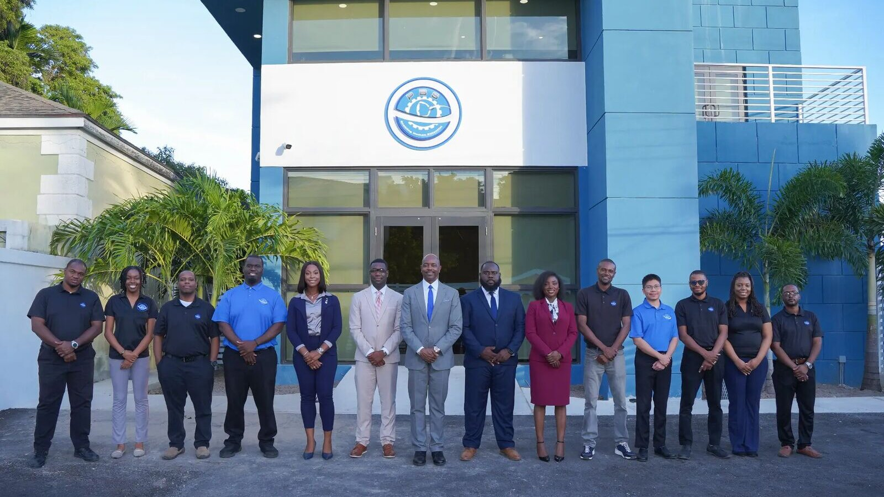
OUR RESPONSIBILITY OVER THE NEXT FIVE WEEKS
What does PBS most need from us as an executive team to move forward successfully?
Thank you
Notes:
• Leave us with this question.
• Bring your perspective, listen carefully, follow up.
• Apply Mr. Roberts’ lessons to your leadership and area.
• Value shows in the decisions we make and follow through on.
• Optional (≈5 min): each executive names one issue Q4 must resolve.

